Slide 1
RESOURCE NOTES:
The following slides are a collection of extracts and resources that could be used to compliment teaching on Pablo Fanque.
The resources are not prescriptive, but are intended to be used in a variety of ways to suit a number of lessons and teaching approaches.
Whether teaching Dickens (Hard Times is particularly good for its references to the circus) or the industrial revolution, there is plenty here to stimulate thought and discussion. Some suggestions are given in this regard.

Slide 2
Pablo Fanque
Life, Entertainment, Leisure and Business in Victorian Britain

Slide 3
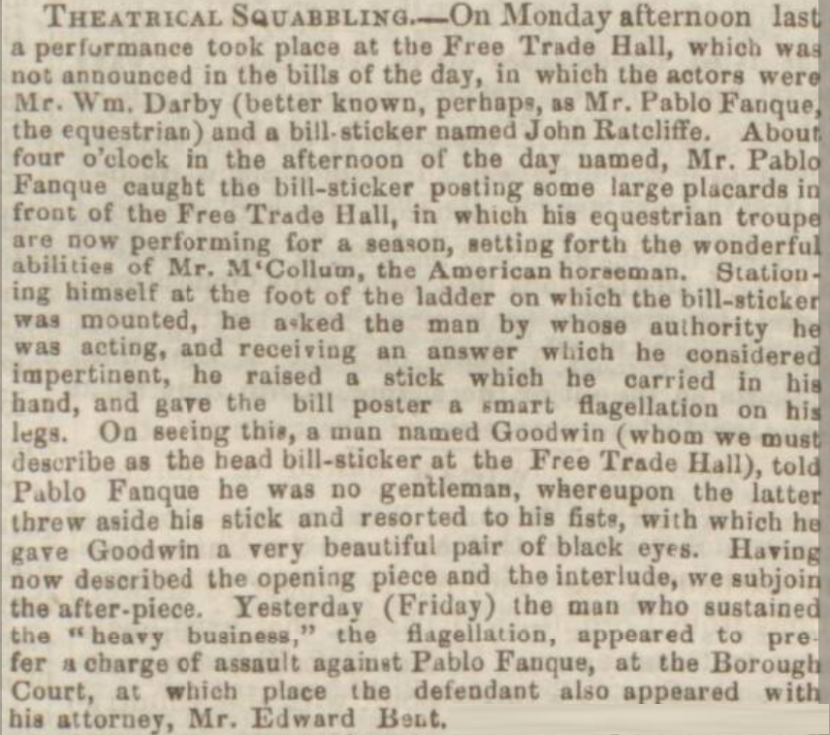
Source 1:
Manchester Courier and Lancashire General Advertiser, Saturday 27 March 1852
Questions:
What might the report reveal about the nature of showbusiness in the Victorian era?
What do Pablo’s actions reveal about his character?
What might this report reveal about the nature of advertising in the Victorian era?
If we consider Pablo’s reaction, how precarious do you think business might have been at this time?

Slide 4
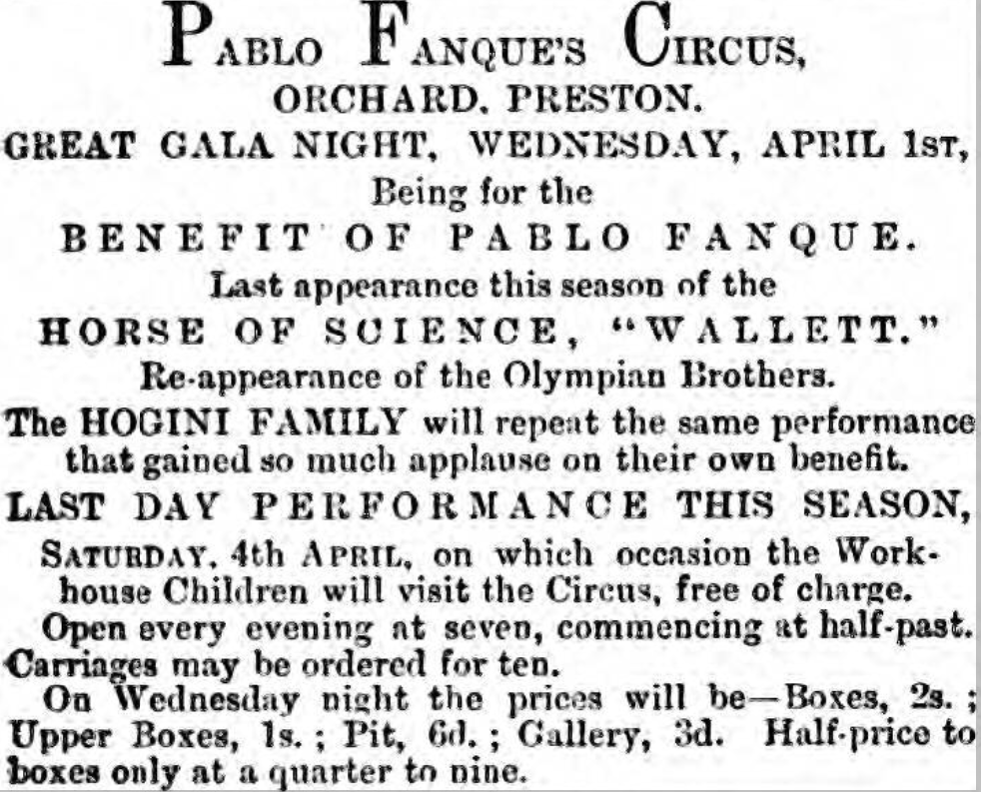
Source 2:
Preston Herald, Saturday 04 April 1868
Questions:
What might the report reveal about the nature of showbusiness in the Victorian era?
What does the extract tell us about Pablo’s attitude towards the poor?
What might this report reveal about the nature of advertising in the Victorian era?
What does the extract tell us about audiences in the 19th Century?

Slide 5
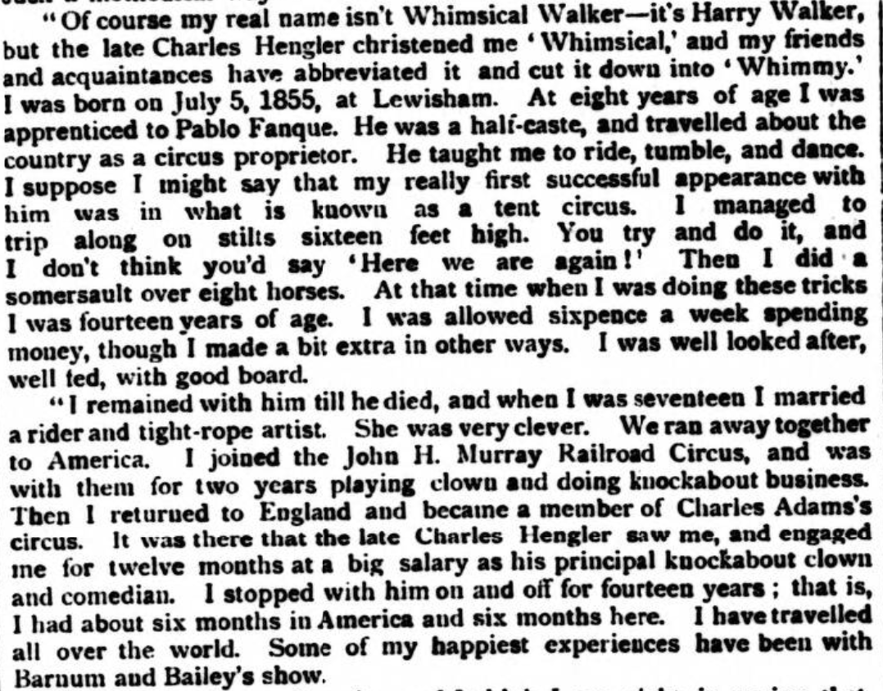
Source 3:
Pall Mall Gazette, Wednesday 22 January 1902
Questions:
What does the extract tell us about life for a circus apprentice?
What does the extract tell us about Pablo Fanque’s character?
How important was Pablo Fanque in the development of circus performers?
What type of audiences were likely to have enjoyed the performances of clowns in the circus?

Slide 6
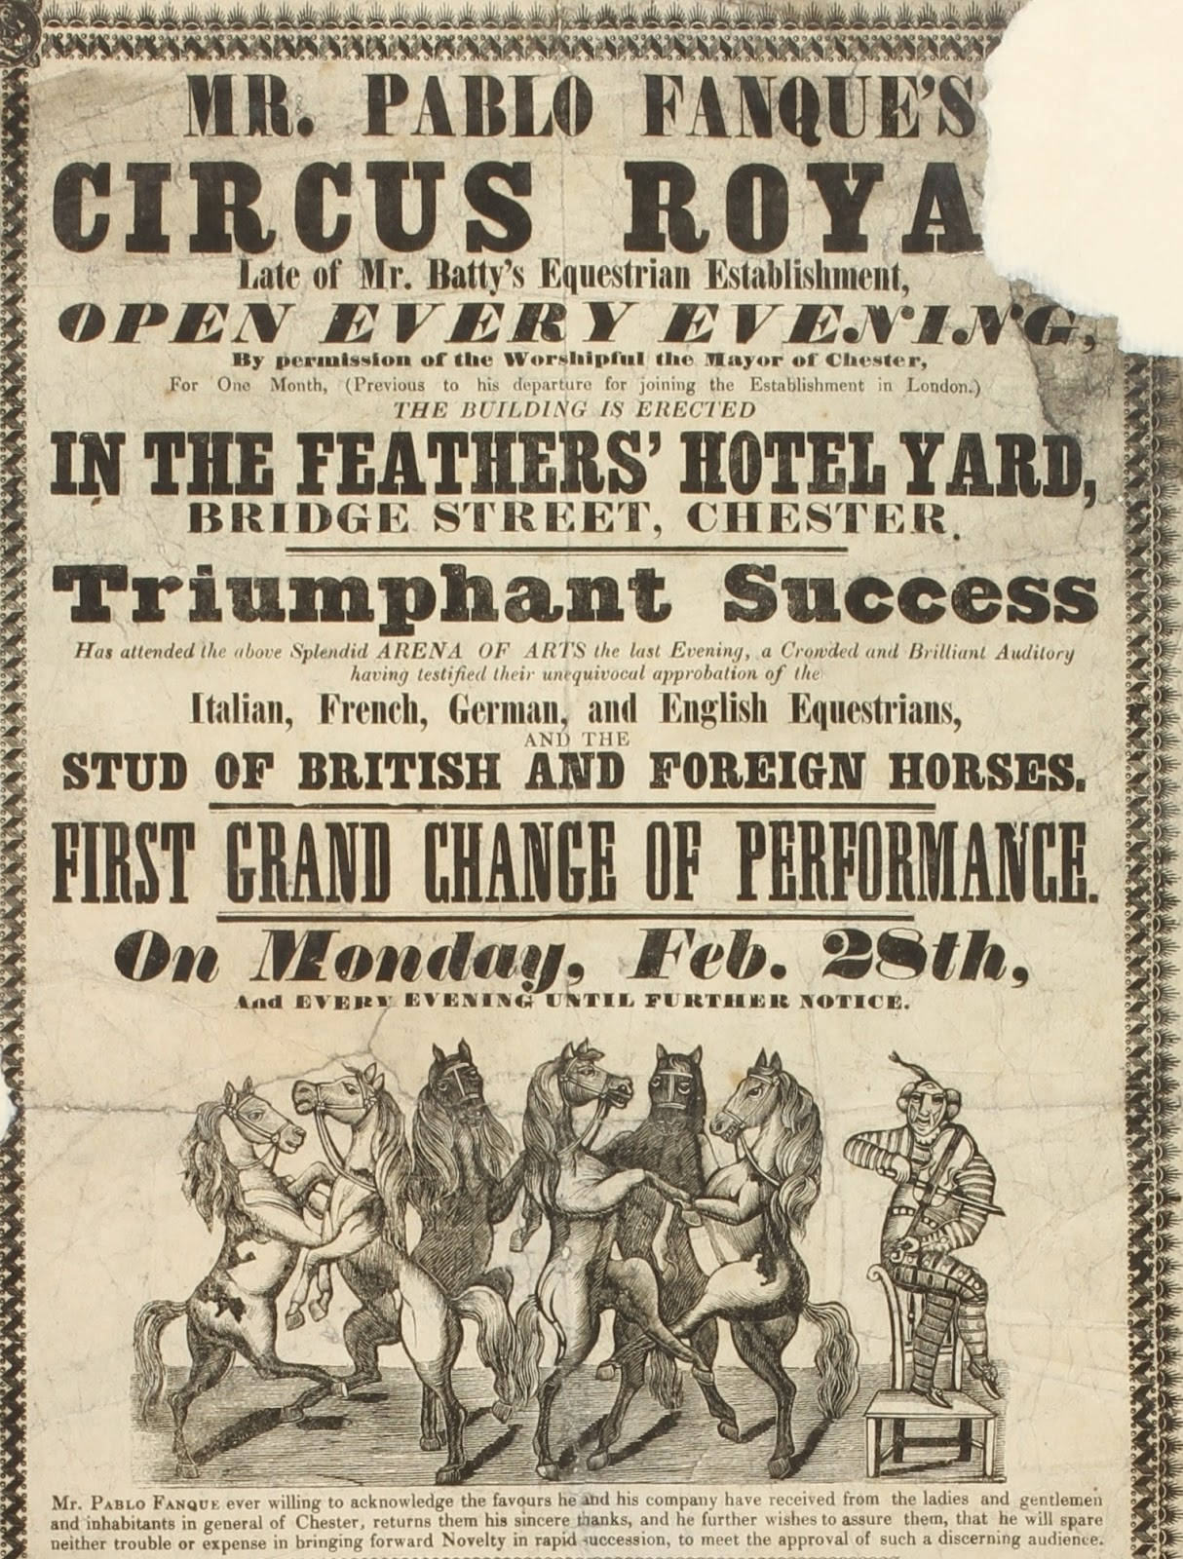
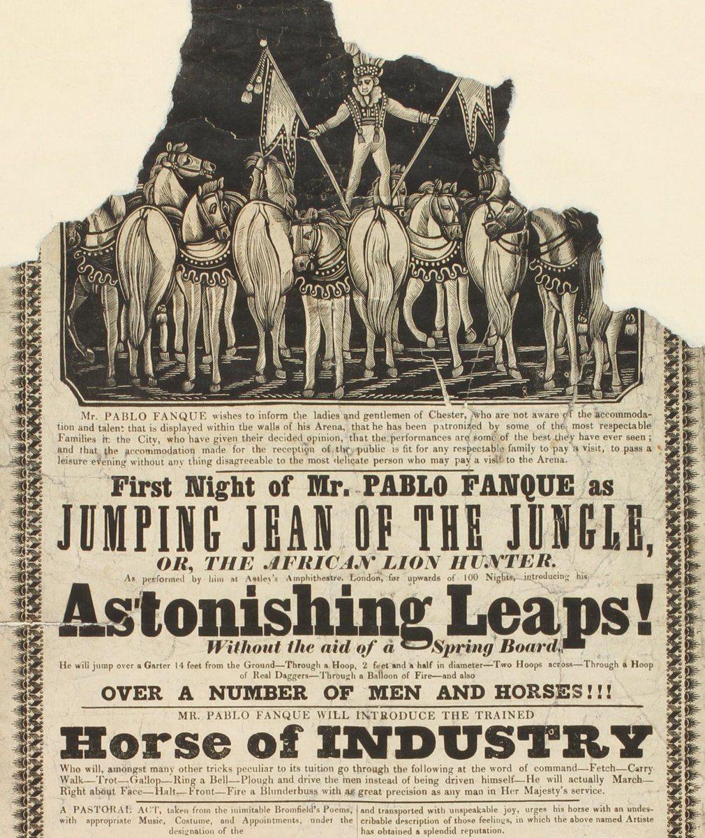
Source 4:
Advertising bills for Pablo’s circus in Chester, c.1848
Questions:
Examine both of the bills very closely. Why do you think Pablo wishes to inform Chester residents that he has the support of ‘respectable families of the City’?
What do these bills tell us about advertising?
Why does Pablo promise ‘novelty in rapid succession’?
What type of audience do you think Pablo wanted to attract?

Slide 7
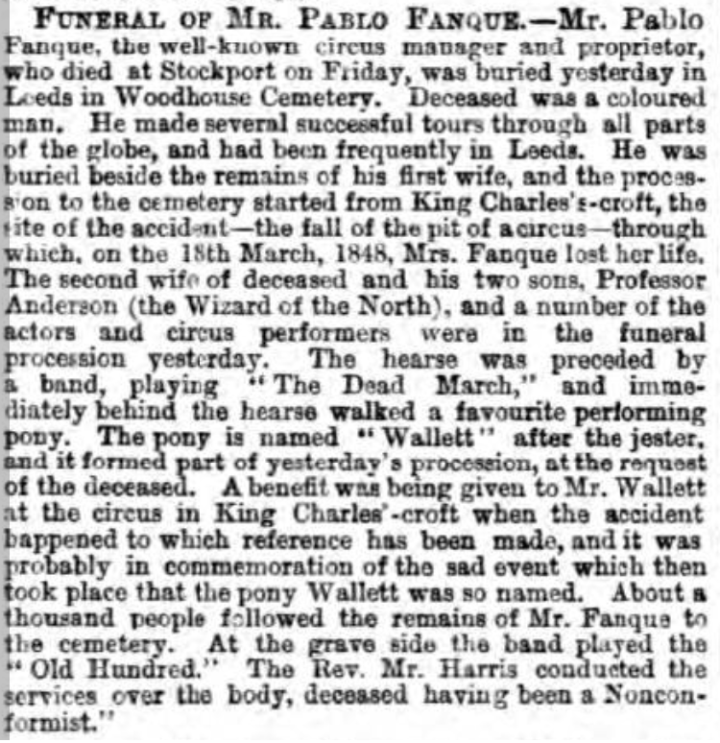
Source 5:
Leeds Mercury, Monday 8 May 1871
Questions:
What does the extract tell us about life for a circus apprentice?
What does the extract tell us about Pablo Fanque’s character?
How important was Pablo Fanque in the development of circus performers?
What type of audiences were likely to have enjoyed the performances of clowns in the circus?

